Slide 1



Low Frequency Unsteadiness in Laminar Separation Bubbles
Alek Cotnoir
NASA Space Grant Undergraduate Research Symposium
April 17th, 2021
Mentor: Dr. Jesse Little
Department of Aerospace and Mechanical Engineering
Partially Funded by NSF

Slide 2
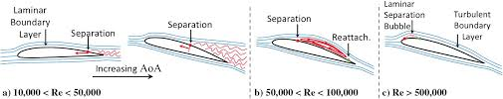
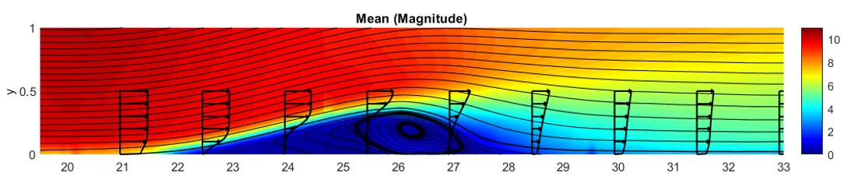
Laminar Separation Bubble (LSB)
Form in wall bounded flows when subjected to a strong adverse pressure gradient
Area of slow moving/circulating air
Modifies effective shape of airfoil
Impacts aerodynamic performance
Winslow, J., Otsuka, H. ,Govindarajan, B., Chopra, I., “Basic Understanding of Airfoil Characteristics at Low Reynolds Numbers,” Journal of Aircraft, Vol. 55, No. 3. May-June 2018

Slide 3
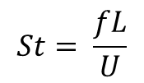
Low Frequency Behavior in the LSB
Expansion and contraction of LSB called ‘breathing’
Observed in subsonic to supersonic regimes
Breathing frequency increases as bubble size decreases
Detrimental to aircraft performance
  Loss of lift
  Component fatigue
  Propulsion system complications
Strouhal Number =>
$$St= \frac{fL}{U}$$
Weiss, J., Little, J., Threadgill, J., “Low-Frequency Unsteadiness in Pressure-Induced Separation Bubbles,” AIAA Sci-Tech Forum. January 2021

Slide 4
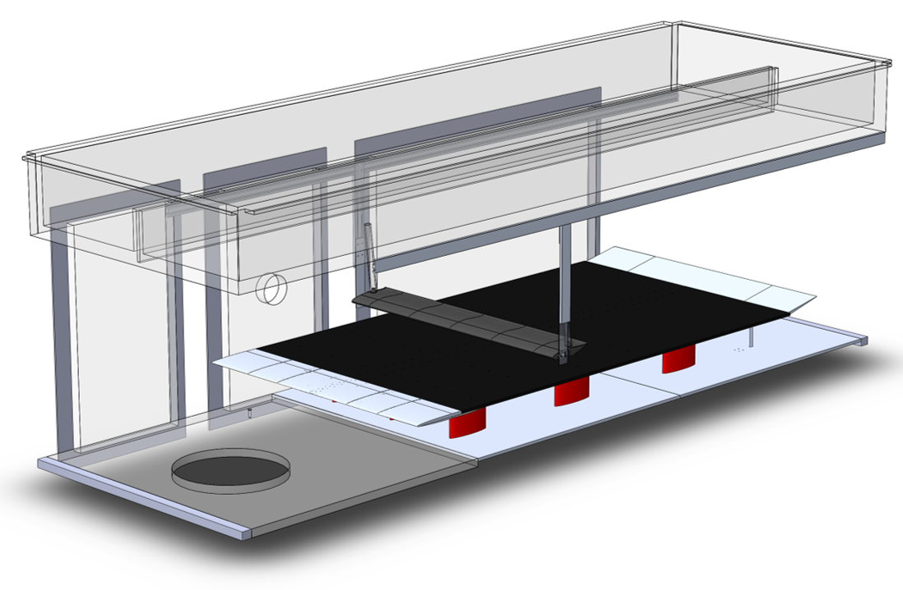
Experimental Setup
Aluminum honeycomb plate
  78 in. x 47.75 in. x 0.5 in. (1.98 m x 1.22 m x 13mm)
  1mm solid aluminum skin
  Flatness: +/-0.665 mm/m (+/-0.008 in./Ft.)
Leading edge:
  1:20 superellipse (Lin et al. 1992)
Adjustable trailing edge flap
Elevated to 8.25 in. above the tunnel floor
Displacement Body:
  8 in. chord x 46 in. span
CTA Probe
Sting
Wing
Plasma Actuator
Flow
Leading Edge
Flat Plate
Adjustable Flap

Slide 5
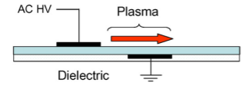
Equipment
Alternating Current Dielectric Barrier Discharge (AC-DBD) Actuator
Active flow control
Provide flow with disturbances of known frequency and amplitude
Constant Temperature Anemometry (CTA) Probe
Small wire between two prongs
Current run through wire
Airflow changes temperature (and thus resistance) of wire
Resistance measured and airflow speed known
Good for frequency measurements
Moreau, E., “Airflow Control By Non-Thermal Plasma Actuators,” J. Phys. D: Appl. Phys., 40 605, 2007

Slide 6
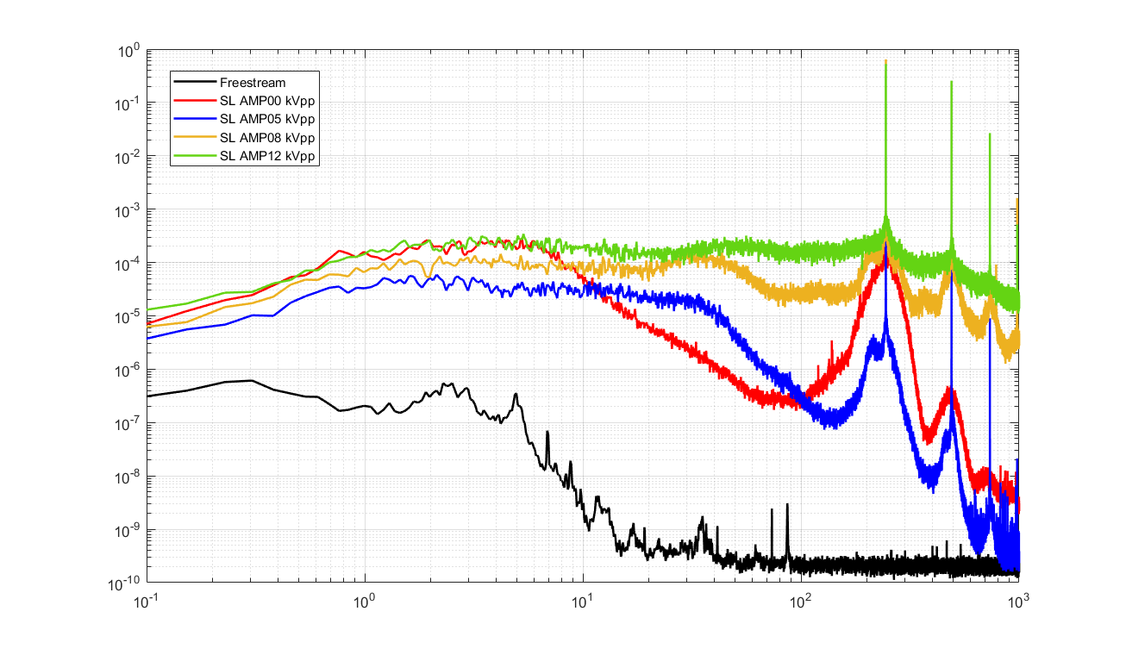

PSD at Shear Layer for Different Forcing Amplitudes
Sampled at 2500 Hz
Forced at 245 Hz
Shedding frequency at 245 Hz
Very little frequency content in freestream
PSD ($\frac{V^{2}}{Hz})$
Measurement Location
Frequency (Hz)

Slide 7
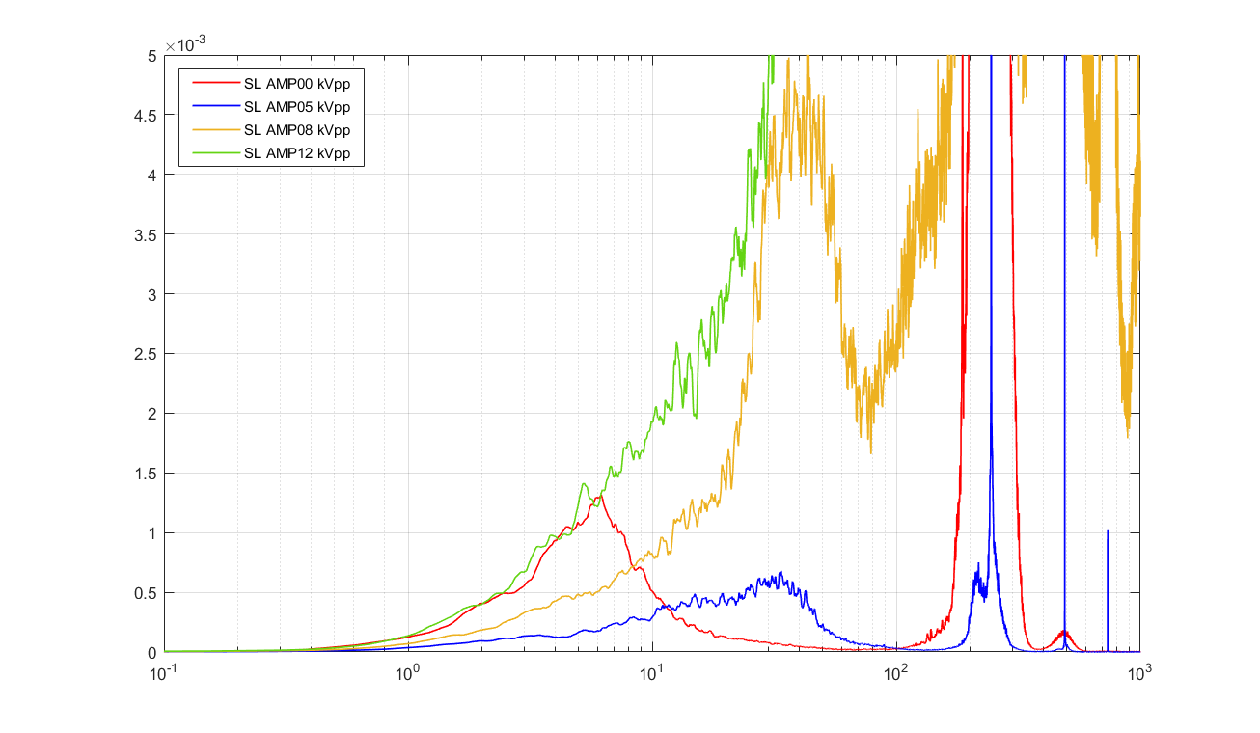
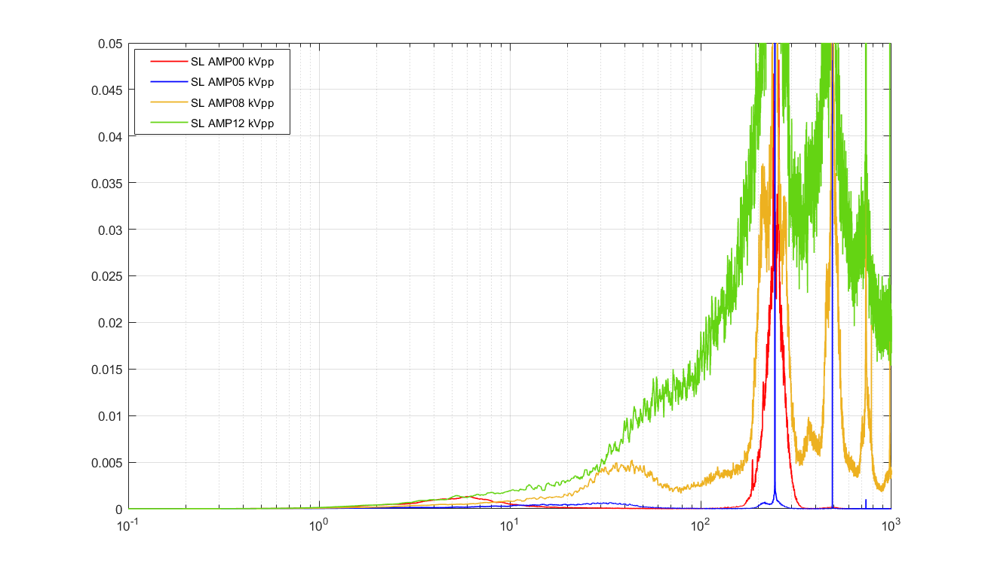


Pre-Multiplied PSD at Shear Layer for Different Forcing Amplitudes
6 Hz ‘breathing’ with no forcing
30 Hz ‘breathing’ with 5 kVpp forcing
Transition to turbulence likely with 8 and 12 kVpp forcing
Smaller bubble size =>measurement is further downstream relative to bubble
f*PSD ($V^{2})$
f*PSD ($V^{2})$
Frequency (Hz)
Frequency (Hz)

Slide 8
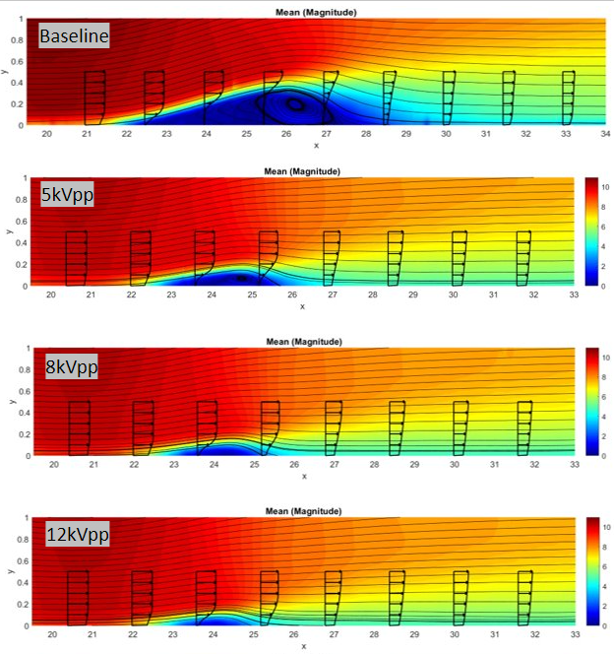
Effect of Forcing on Bubble Size
Higher forcing amplitude reduces bubble size

Slide 9
Conclusion
Next Steps
‘Breathing’ behaves as expected
  Forcing => smaller bubble size
  Smaller bubble size => higher breathing frequency
  Forcing => higher breathing frequency
Optimize forcing
  Decrease actuator height
  Decrease distance between actuator and bubble
  Decrease required forcing amplitude
  Eliminate turbulent behavior

Slide 10
Acknowledgements
Dr. Jesse Little
Dr. James Threadgill
David Borgmann, PhD Student
The Aerospace and Mechanical Engineering Department
The Arizona Space Grant Team
National Science Foundation

Slide 11
Thank You

